Slide 1

Evaluating Docker as an edge computing platform
Che Calder

Slide 2
Introduction

Slide 3
The Agenda
Brief Overview of Edge Computing
How and why docker has been used
Cover the methodology of the experiment and the overall paper
Review some of the potential contributions of the paper
Discuss the results and the wider implications of the research

Slide 4

What is Edge computing?
Distributed Computation
Preprocessing and Filtering
Smart decision making
Save Bandwidth
Emergent Technology

Slide 5
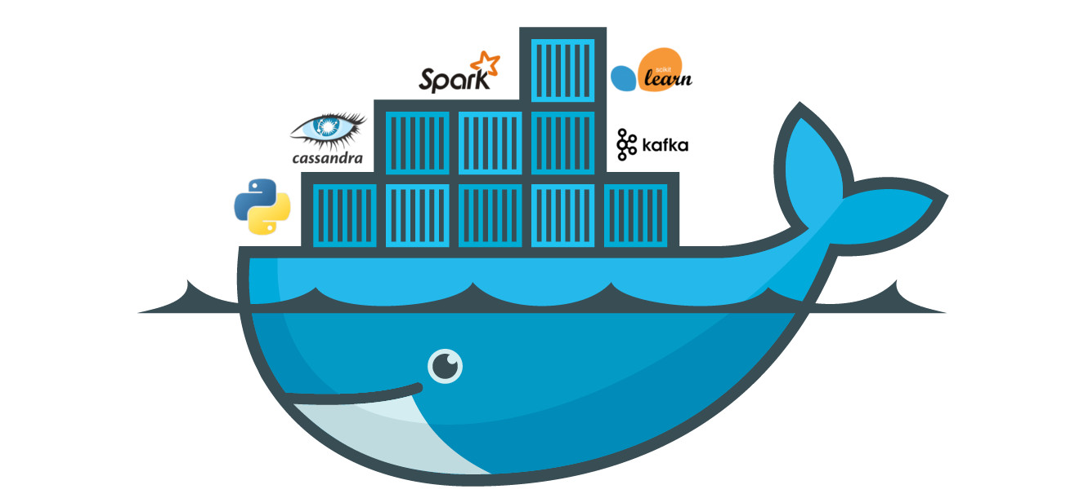
Postulations on Docker
Imaging
Containers
Configuration
Cluster orchestration and management tools (dockerswarm)
Docker shipyard

Slide 6

What is the motivation of this paper?
Reduce System Strain
Speed of systems
Security Bolstering
Increase Reliability
Tesla vs Waymo
Nasa Weather Balloons

Slide 7
Methodology and Contributions

Slide 8
System Architecture for Experiment
Data Center administrating overall system
Dockerfile at data centre
Multiple Edge Clusters
Edge Cluster Registry Caching
I will now explain the architecture in greater detail from the bottom up

Slide 9
End-User Running Containers/Applications
Users typically receive Docker images from edge devices to construct and run containers locally.
In other cases, users simply access an application hosted by the edge (they never run a container themselves).
Docker is not always required on the user device—they might only interact with an edge-hosted application.

Slide 10
Edge Cluster – docker swarm and docker clients
Receive container workloads from the Swarm Manager.
Can run containers locally or forward images to end-user devices.
May cache frequently used images to speed up deployments.
Typically run Docker Swarm Worker mode but could be standalone Docker Clients.
Central controller for managing the Docker Swarm cluster (other workers).
Assigns tasks (container deployments) to edge nodes.
Maintains a global view of cluster health.
Listens for container deployment requests from edge client devices.

Slide 11
Docker Shipyard
Docker Shipyard provides an easy UI for monitoring and controlling Swarm.
Edge nodes (workers) register with Swarm, allowing centralized monitoring & management.
The data center administrator controls the edge containers remotely via Shipyard’s UI.
Is a more user friendly alternative than accessing swarm operations via ssh or some kind of cli interface

Slide 12

Contribution
Faster and more efficient distributed computing model
Created an alternative to virtual machine reliant Edge Computing Solutions
More reliable business models without exposure
Smart Cities – Shenzen

Slide 13

Conclusions and discussion

Slide 14

Evaluation
This paper measured performance against these 4 criteria:
Deployment and termination
Resource and Service Management
Fault Tolerence
Caching
I will now discuss its effectiveness in these areas and how these become applicable

Slide 15

Deployment and Termination
Docker Agility - Docker images are small and lightweight.
It makes Docker agile, portable and easy to transport.
Containerization enables fast deployment and termination
Docker Shipyard - topdown
Notes:
Runs on top of operating system so it does not require as much resource allocation to start and tear down

Slide 16
Resource and Service Management
Paper compares Docker with
VM running on hypervisor, hypervisor occupies about 10 to
15 % of host resources but Docker use minimally the host
resources
Since Docker
container does not virtualize hardware, Docker container is
much lightweight and fast. In average, a Docker container run
26X faster than a VM

Slide 17

Fault Tolerence & Caching
Self contained allows uncoupled dependencies on each instance
Offline versatility
Separated edge clusters
Locational system – physical risk reduction (security tradeoff)
Image caching
Application data caching
Decoupling data from services

Slide 18
Conclusion
Overall Docker provides fast deployment, elasticity and good performance over VM based EC platform. It makes Docker much attractive technology as compared to virtualization based EC technology.
Security Enhancement enables businesses to reliably access and run applications without reliance on third parties, unforeseen disaster, or cyber crime
As larger and larger data sets are being absorbed, edge computing is a necessary intermediary distributed compute model that could accelerate the wider growth of an already flourishing artificial intelligence market.
High abstraction and hierarchical management of lower level machines and systems enables key scaling potential.

